Slide 1
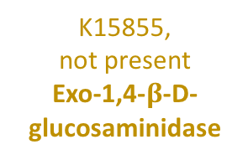
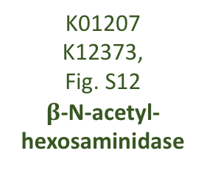
K01183, Fig. S10
Chitinase
Chitin
Chitobiose
N-acetyl-D-glucosamine
N-acetyl-D-glucosamine-6-phosphate
K01183, Fig. S10
Chitinase
K01207
K12373,
Fig. S12
$β$-N-acetyl-hexosaminidase
K00884,
Fig. S13
N-acetyl- glucosamine kinase
K01452, Fig. S11
Chitin deacetylase
K01443
Fig. S13
N-acetyl-glucosamine-6-phosphate deacetylase
Chitosan
D-glucosaminide
D-glucosamine
D-glucosamine-6-phosphate
K01233,
not present
Chitosanase
K15855,
not present
Exo-1,4-$β$-D-glucosaminidase
K00884
K18676
Fig. S13
Hexokinase, Glucosamine kinase
K02564, Fig. S13
Glucosamine-6-phosphate deaminase
Fructose-6-phosphate

